Slide 1
With Array Representation
For any node tree.nodes[index]
  its left child is in tree.nodes[index*2 + 1]
  right child is in tree.nodes[index*2 + 2]
  its parent is in tree.nodes[(index – 1)/2].

Slide 2
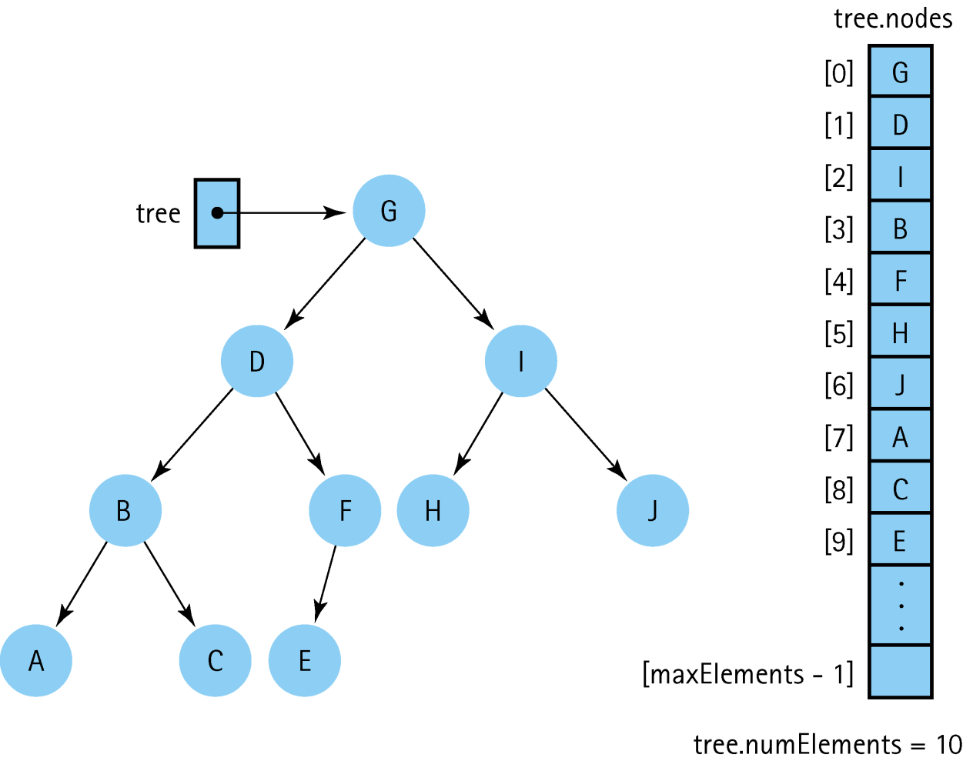
A Binary Tree and Its
Array Representation

Slide 3
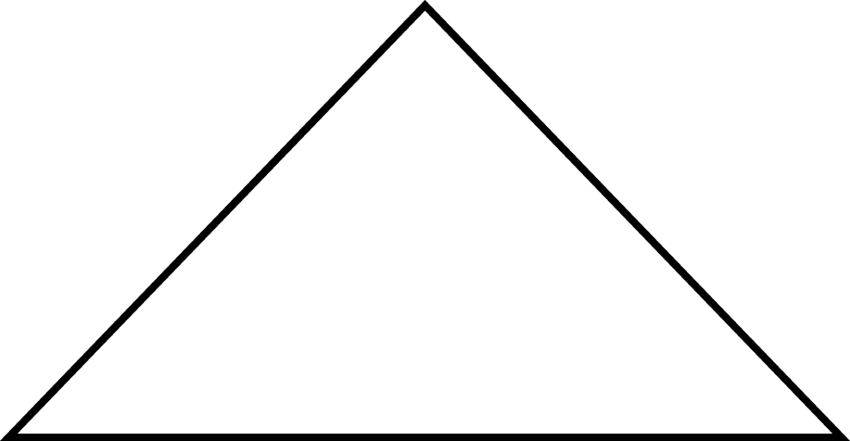
Definitions
Full Binary Tree: A binary tree in which all of the leaves are on the same level and every nonleaf node has two children

Slide 4
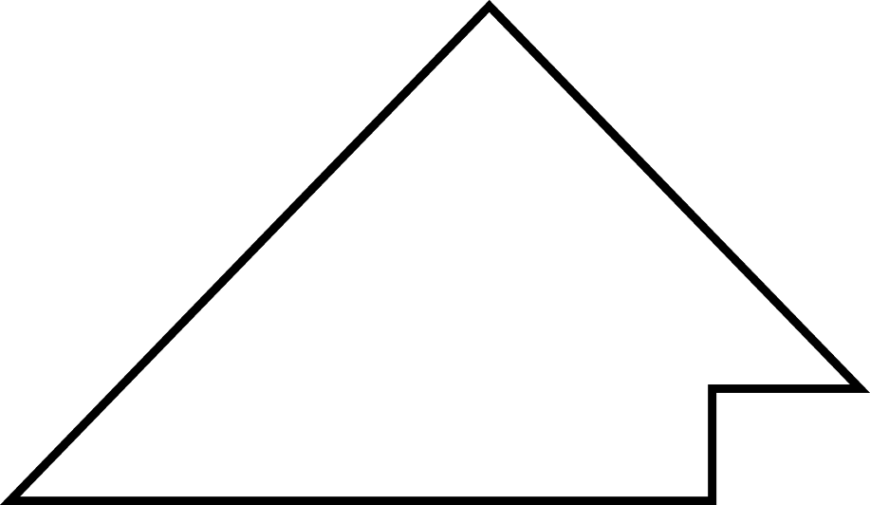
Definitions (cont.)
Complete Binary Tree: A binary tree that is either full or full through the next-to-last level, with the leaves on the last level as far to the left as possible

Slide 5
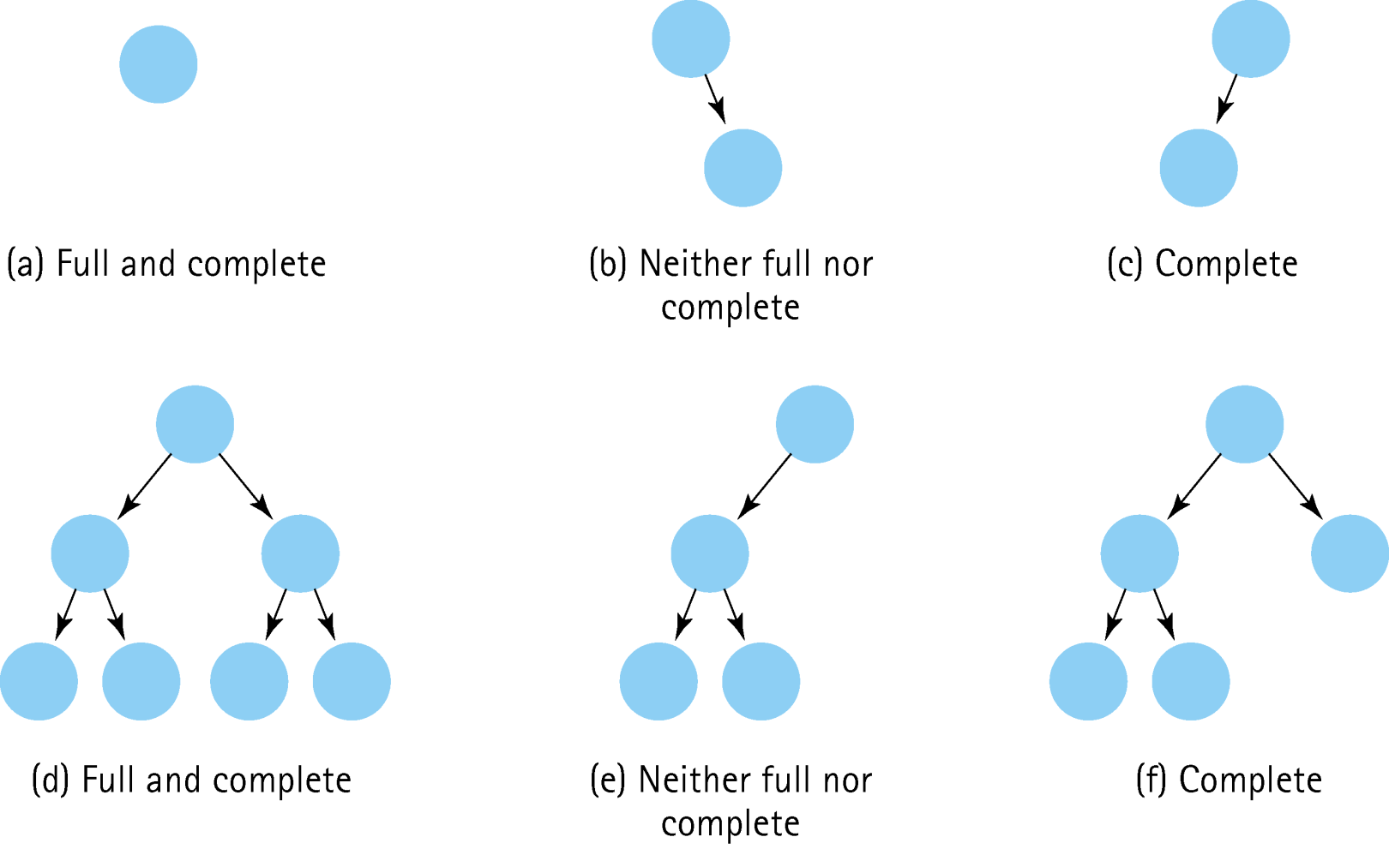
Examples of Different Types of Binary Trees

Slide 6
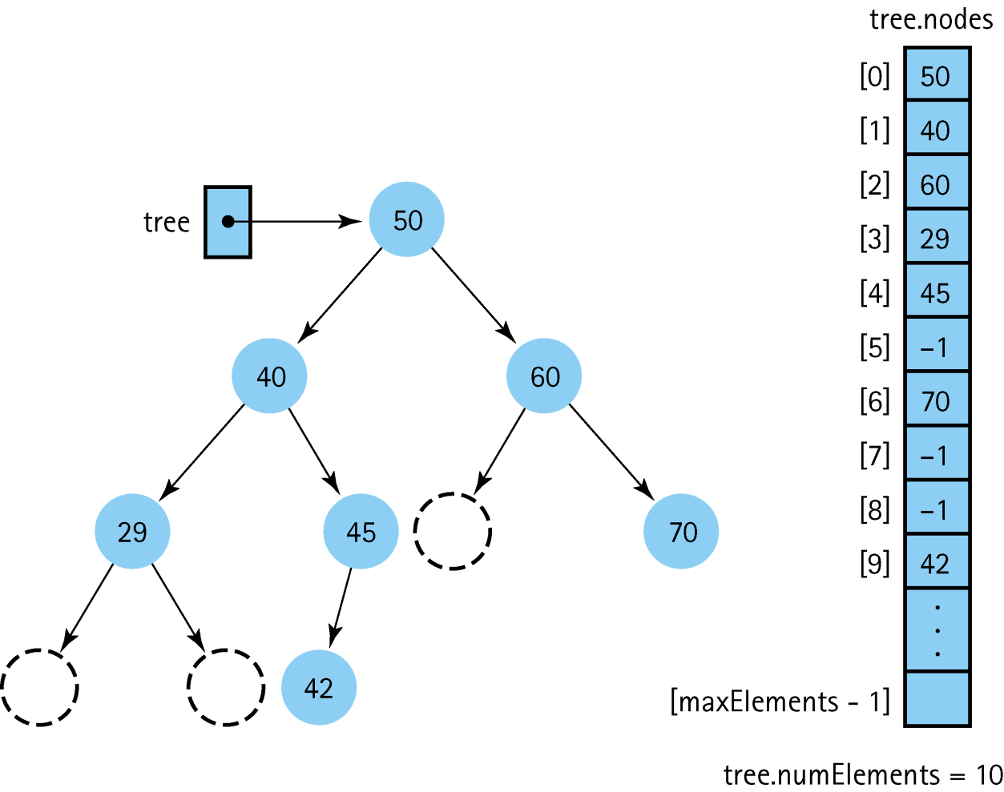
A Binary Search Tree Stored in an Array with Dummy Values

Slide 7
AVL Tree Example
Balancing in a tree

Slide 8
AVL Tree
In computer science, an AVL tree (Adelson-Velskii and Landis' tree, named after the inventors) is a self-balancing binary search tree.

Slide 9
Each node of an AVL tree is assigned a balance factor as follows:
-1 if the depth of the node’s left subtree is 1 more than the depth of the right node’s left sub tree
+1 if the depth of the node’s left sub tree is 1 more than the depth of the right node’s left subtree
0 if both of the node’s subtrees has the same depths
-2 if the depth of the node’s left subtree is 2 more than the depth of the right node’s left sub tree
+2 if the depth of the node’s left sub tree is 2 more than the depth of the right node’s left subtree
If the balance factor becomes -2 or +2, the tree must be rebalanced.
NOTE: the version of AVL implemented can have the +/- reversed from above. The concept works either way as WHEN to rotate to balance depends on the number (not the sign). The sign would come into play when coding to determine which WAY to rotate.
Next: Rotations -->

Slide 10
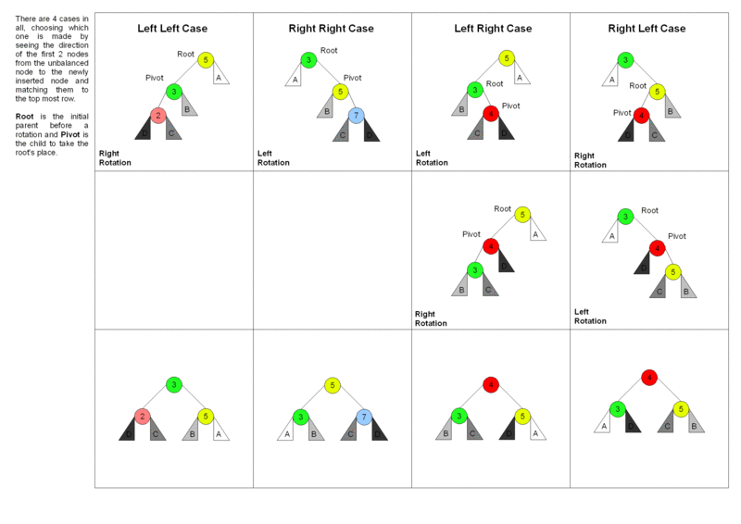
If the balance factor of a node in an AVL tree is +2 or -2, the node is rotated to re-balance the tree using one of the four cases shown in the following picture:
The 4 cases of AVL tree rebalancing using rotations. Picture created by Marc Tanti, licensed for reuse under the GNU Free Documentation License, Version 1.2
Next: example -->

Slide 11
Initial AVL tree with balance factors:
Balance ok
0
57
0
26
+1
72
-1
25
0
38
0
63
-1
94
0
3
0
37
0
47
0
78
Next step: insert 1 -->

Slide 12
Insert 1 and recalculate balance factors
Balance not ok
(Balance factor of -2 is not allowed)
-1
57
-1
26
+1
72
-2
25
0
38
0
63
-1
94
-1
3
0
37
0
47
0
78
0
1
Next step: Find rebalancing case -->

Slide 13
Balance not ok
Find rebalancing case
-1
57
-1
26
+1
72
Left Left Case
-2
25
0
38
0
63
-1
94
Pivot
-1
3
0
37
0
47
0
78
0
1
Next step: apply Left Left rebalancing -->

Slide 14
Balance ok
Rebalance and recalculate balance factors
0
57
0
26
+1
72
0
3
0
38
0
63
-1
94
0
1
0
25
0
37
0
47
0
78
Next step: insert 30 -->

Slide 15
Balance ok
Insert 30 and recalculate balance factors
-1
57
+1
26
+1
72
0
3
-1
38
0
63
-1
94
0
1
0
25
-1
37
0
47
0
78
0
30
Next step: Insert 32 -->

Slide 16
Balance not ok
Insert 32 and recalculate balance factors
-2
57
+2
26
+1
72
0
3
-2
38
0
63
-1
94
0
1
0
25
-2
37
0
47
0
78
+1
30
0
32
Next step: Find rebalancing case -->

Slide 17
Balance not ok
Find rebalancing case
-2
57
+2
26
+1
72
0
3
-2
38
0
63
-1
94
0
1
0
25
-2
37
0
47
0
78
+1
30
Left Right Case
0
32
Next step: Rebalance (Step 1) -->

Slide 18
Balance not ok
Rebalance (Step 1)
-2
57
+2
26
+1
72
0
3
-2
38
0
63
-1
94
0
1
0
25
-2
37
0
78
0
47
-1
32
0
30
Next step: Rebalance (Step 2) -->

Slide 19
Balance ok
Rebalance (Step 2) and recalculate balance factors
-1
57
+1
26
+1
72
0
3
-1
38
0
63
-1
94
0
1
0
25
0
32
0
47
0
78
0
30
0
37
Next step: Insert 35 -->

Slide 20
Balance not ok
Insert 35 and recalculate balance factors
-2
57
+2
26
+1
72
0
3
-2
38
0
63
-1
94
0
1
0
25
+1
32
0
47
0
78
0
30
-1
37
0
35
Next step: Find rebalancing case -->

Slide 21
Balance not ok
Insert 35
-2
57
+2
26
Start from first spot (from bottom of tree) where balance factor is incorrect.
+1
72
0
3
-2
38
0
63
-1
94
0
1
0
25
+1
32
0
47
0
78
Left Right Case
0
30
-1
37
0
35
Next step: Rebalance (Step 1) -->

Slide 22
Balance not ok
Rebalance (Step 1)
-2
57
+2
26
+1
72
0
3
-2
38
0
63
-1
94
0
1
0
25
-2
37
0
47
0
78
0
32
0
30
0
35
Next step: Rebalance (Step 2) -->

Slide 23
Balance ok
Rebalance (Step 2)
-1
57
+1
26
+1
72
0
3
0
37
0
63
-1
94
0
1
0
25
0
32
+1
38
0
78
0
30
0
35
0
47
Next step: Finished! -->

Slide 24
Balance ok
Finished!
-1
57
+1
26
+1
72
0
3
0
37
0
63
-1
94
0
1
0
25
0
32
+1
38
0
78
0
30
0
35
0
47

